Slide 1
CS162
Operating Systems and
Systems Programming
Lecture 17
I/O Systems (Con’t)
Disk Performance and Queueing Models
November 1st, 2010
Prof. John Kubiatowicz
http://inst.eecs.berkeley.edu/~cs162

Slide 2
Review: Want Standard Interfaces to Devices
Block Devices: e.g. disk drives, tape drives, Cdrom
  Access blocks of data
  Commands include open(), read(), write(), seek()
  Raw I/O or file-system access
  Memory-mapped file access possible
Character Devices: e.g. keyboards, mice, serial ports, some USB devices
  Single characters at a time
  Commands include get(), put()
  Libraries layered on top allow line editing
Network Devices: e.g. Ethernet, Wireless, Bluetooth
  Different enough from block/character to have own interface
  Unix and Windows include socket interface
    Separates network protocol from network operation
    Includes select() functionality
  Usage: pipes, FIFOs, streams, queues, mailboxes

Slide 3
Review: How Does User Deal with Timing?
Blocking Interface: “Wait”
  When request data (e.g. read() system call), put process to sleep until data is ready
  When write data (e.g. write() system call), put process to sleep until device is ready for data
Non-blocking Interface: “Don’t Wait”
  Returns quickly from read or write request with count of bytes successfully transferred
  Read may return nothing, write may write nothing
Asynchronous Interface: “Tell Me Later”
  When request data, take pointer to user’s buffer, return immediately; later kernel fills buffer and notifies user
  When send data, take pointer to user’s buffer, return immediately; later kernel takes data and notifies user

Slide 4
Goals for Today
Finish Discussing I/O Systems
  Hardware Access
  Device Drivers
Disk Performance
  Hardware performance parameters
  Queuing Theory
File Systems
  Structure, Naming, Directories, and Caching
Note: Some slides and/or pictures in the following are
adapted from slides ©2005 Silberschatz, Galvin, and Gagne
Note: Some slides and/or pictures in the following are
adapted from slides ©2005 Silberschatz, Galvin, and Gagne. Many slides generated from my lecture notes by Kubiatowicz.

Slide 5
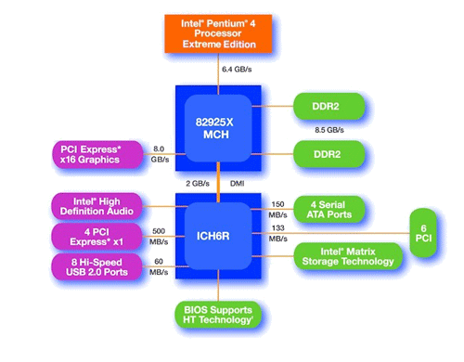
Main components of Intel Chipset: Pentium 4
Northbridge:
  Handles memory
  Graphics
Southbridge: I/O
  PCI bus
  Disk controllers
  USB controllers
  Audio
  Serial I/O
  Interrupt controller
  Timers

Slide 6

How does the processor talk to the device?
Processor Memory Bus
Regular
Memory
CPU
Bus
Adaptor
Bus
Adaptor
Device
Controller
Address+
Data
Other Devices
or Buses
Bus
Interface
Hardware
Controller
Interrupt
Controller
Interrupt Request
read
Addressable
Memory
and/or
Queues
write
CPU interacts with a Controller
  Contains a set of registers that
  can be read and written
  May contain memory for request
  queues or bit-mapped images
Regardless of the complexity of the connections and buses, processor accesses registers in two ways:
  I/O instructions: in/out instructions
    Example from the Intel architecture: out 0x21,AL
  Memory mapped I/O: load/store instructions
    Registers/memory appear in physical address space
    I/O accomplished with load and store instructions
control
status
Registers
(port 0x20)
Memory Mapped
Region: 0x8f008020

Slide 7
Memory-Mapped Display Controller Example
Memory-Mapped:
  Hardware maps control registers and display memory to physical address space
    Addresses set by hardware jumpers or programming at boot time
  Simply writing to display memory (also called the “frame buffer”) changes image on screen
    Addr: 0x8000F000—0x8000FFFF
  Writing graphics description to command-queue area
    Say enter a set of triangles that describe some scene
    Addr: 0x80010000—0x8001FFFF
  Writing to the command register may cause on-board graphics hardware to do something
    Say render the above scene
    Addr: 0x0007F004
Can protect with page tables
0x80020000
Graphics
Command
Queue
0x80010000
Display
Memory
0x8000F000
0x0007F004
Command
0x0007F000
Status
Physical Address
Space

Slide 8

Transferring Data To/From Controller
Programmed I/O:
  Each byte transferred via processor in/out or load/store
  Pro: Simple hardware, easy to program
  Con: Consumes processor cycles proportional to data size
Direct Memory Access:
  Give controller access to memory bus
  Ask it to transfer data to/from memory directly
Sample interaction with DMA controller (from book):

Slide 9
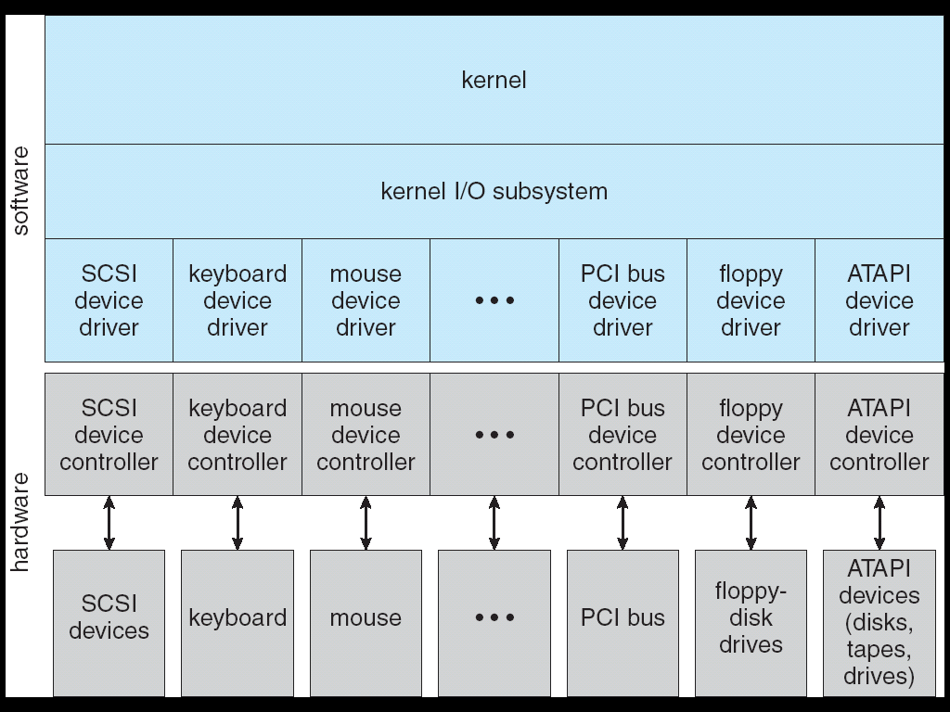
A Kernel I/O Structure

Slide 10
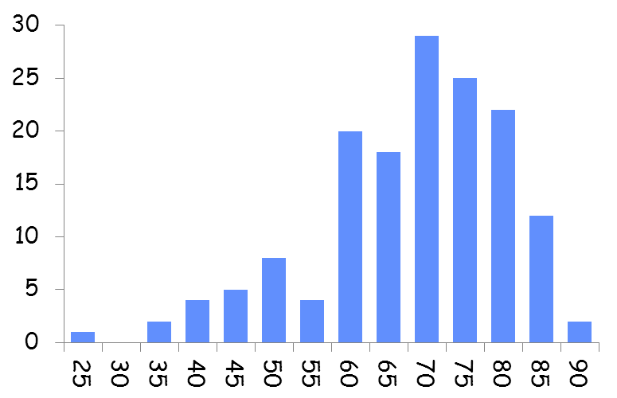
Administrivia
Midterm I results:
  Mean: 69.9, STD: 12.3
  Min: 27.5, Max: 90.5
Group Evaluations
(Both Projects 1 and 2)
  These MUST be done:
  you will get ZERO if you
  don’t fill them out
  Fill them out honestly
  (you may be asked about them)
Projects are a zero-sum game
  If you don’t contribute (and help in the debugging) you can end up with a ZERO for the projects!
Other things
  Group problems? Don’t wait.
  Talk to TA/talk to me: Let’s get things fixed!
Midterm II. Well, we have a room and interest. So…

Slide 11
Device Drivers
Device Driver: Device-specific code in the kernel that interacts directly with the device hardware
  Supports a standard, internal interface
  Same kernel I/O system can interact easily with different device drivers
  Special device-specific configuration supported with the ioctl() system call
Device Drivers typically divided into two pieces:
  Top half: accessed in call path from system calls
    implements a set of standard, cross-device calls like open(), close(), read(), write(), ioctl(), strategy()
    This is the kernel’s interface to the device driver
    Top half will start I/O to device, may put thread to sleep until finished
  Bottom half: run as interrupt routine
    Gets input or transfers next block of output
    May wake sleeping threads if I/O now complete

Slide 12
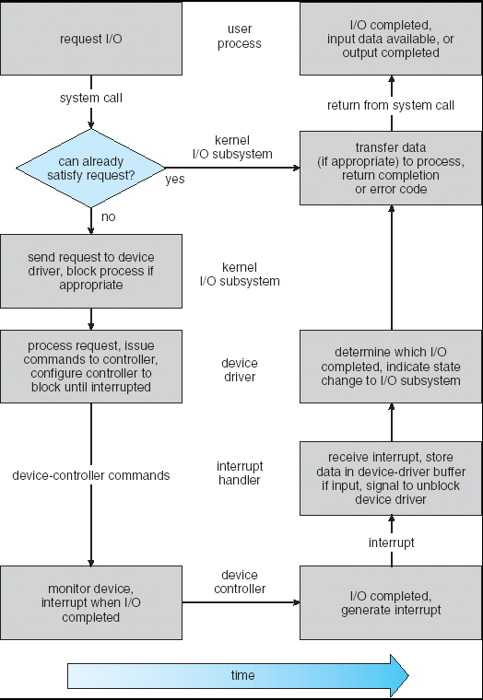
Life Cycle of An I/O Request
User
Program
Kernel I/O
Subsystem
Device Driver
Top Half
Device Driver
Bottom Half
Device
Hardware

Slide 13
I/O Device Notifying the OS
The OS needs to know when:
  The I/O device has completed an operation
  The I/O operation has encountered an error
I/O Interrupt:
  Device generates an interrupt whenever it needs service
  Handled in bottom half of device driver
    Often run on special kernel-level stack
  Pro: handles unpredictable events well
  Con: interrupts relatively high overhead
Polling:
  OS periodically checks a device-specific status register
    I/O device puts completion information in status register
    Could use timer to invoke lower half of drivers occasionally
  Pro: low overhead
  Con: may waste many cycles on polling if infrequent or unpredictable I/O operations
Actual devices combine both polling and interrupts
  For instance: High-bandwidth network device:
    Interrupt for first incoming packet
    Poll for following packets until hardware empty
Notes:
After the OS has issued a command to the I/O device either via a special I/O instruction or by writing to a location in the I/O address space, the OS needs to be notified when:
(a) The I/O device has completed the operation.
(b) Or when the I/O device has encountered an error.
This can be accomplished in two different ways: Polling and I/O interrupt.
+1 = 58 min. (Y:38)

Slide 14
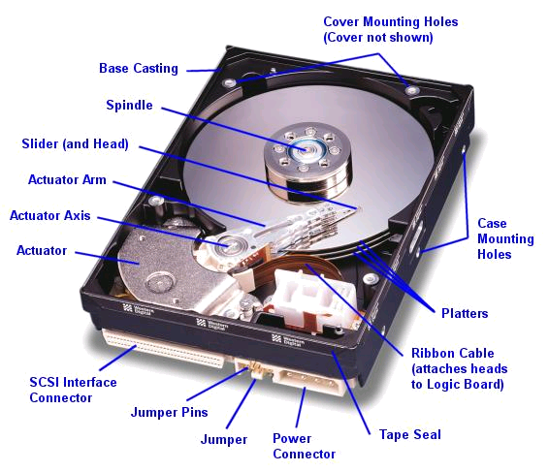
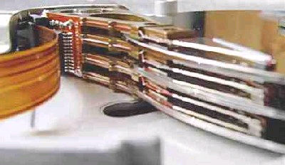
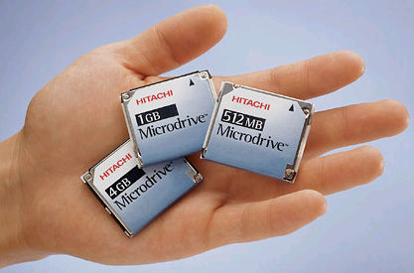
Hard Disk Drives
Read/Write Head
Side View
Western Digital Drive
http://www.storagereview.com/guide/
IBM/Hitachi Microdrive
Notes:
Winchester disk drives developed by IBM: 1973 first drive
Uses “sealed” assembly with heads floating on air bearings – Bernoulli effect

Slide 15
Properties of a Hard Magnetic Disk
Track
Sector
Sector
Head
Cylinder
Track
Platter
Properties
  Head moves in to address circular track of information
  Independently addressable element: sector
    OS always transfers groups of sectors together—”blocks”
  Items addressable without moving head: cylinder
  A disk can be rewritten in place: it is possible to read/modify/write a block from the disk
Typical numbers (depending on the disk size):
  500 to more than 20,000 tracks per surface
  32 to 800 sectors per track
Zoned bit recording
  Constant bit density: more sectors on outer tracks
  Speed varies with track location
Notes:
Here is a primitive picture showing you how a disk drive can have multiple platters.
Each surface on the platter are divided into tracks and each track is further divided into sectors. A sector is the smallest unit that can be read or written.
By simple geometry you know the outer track have more area and you would thing the outer tack will have more sectors.
This, however, is not the case in traditional disk design where all tracks have the same number of sectors. Well, you will say, this is dumb but dumb is the reason they do it .
By keeping the number of sectors the same, the disk controller hardware and software can be dumb and does not have to know which track has how many sectors.
With more intelligent disk controller hardware and software, it is getting more popular to record more sectors on the outer tracks. This is referred to as constant bit density.
+2 = 32 min. (Y:12)

Slide 16
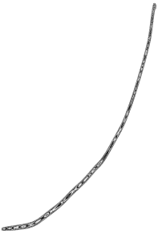
Properties of Magnetic Disk (Con’t)
Performance of disk drive/file system
  Metrics: Response Time, Throughput
  Contributing factors to latency:
    Software paths (can be loosely
    modeled by a queue)
    Hardware controller
    Physical disk media
Queuing behavior:
  Leads to big increases of latency
  as utilization approaches 100%
Response
Time (ms)
300
200
100
0
100%
0%
Throughput (Utilization)
(% total BW)
Notes:
To read write information into a sector, a movable arm containing a read/write head is located over each surface.
The term cylinder is used to refer to all the tracks under the read/write head at a given point on all surfaces.
To access data, the operating system must direct the disk through a 3-stage process.
(a) The first step is to position the arm over the proper track. This is the seek operation and
the time to complete this operation is called the seek time.
(b) Once the head has reached the correct track, we must wait for the desired sector to
rotate under the read/write head. This is referred to as the rotational latency.
(c) Finally, once the desired sector is under the read/write head, the data transfer can begin.
The average seek time as reported by the manufacturer is in the range of 12 ms to 20ms and is calculated as the sum of the time for all possible seeks divided by the number of possible seeks.
This number is usually on the pessimistic side because due to locality of disk reference, the actual average seek time may only be 25 to 33% of the number published.
+2 = 34 min. (Y:14)

Slide 17
Performance Model
Read/write data is a three-stage process:
  Seek time: position the head/arm over the proper track (into proper cylinder)
  Rotational latency: wait for the desired sector
  to rotate under the read/write head
  Transfer time: transfer a block of bits (sector)
  under the read-write head
Disk Latency = Queueing Time + Controller time +
Seek Time + Rotation Time + Xfer Time
Highest Bandwidth:
  Transfer large group of blocks sequentially from one track
Software
Queue
(Device Driver)
Hardware
Controller
Media Time
(Seek+Rot+Xfer)
Request
Result
Notes:
To read write information into a sector, a movable arm containing a read/write head is located over each surface.
The term cylinder is used to refer to all the tracks under the read/write head at a given point on all surfaces.
To access data, the operating system must direct the disk through a 3-stage process.
(a) The first step is to position the arm over the proper track. This is the seek operation and
the time to complete this operation is called the seek time.
(b) Once the head has reached the correct track, we must wait for the desired sector to
rotate under the read/write head. This is referred to as the rotational latency.
(c) Finally, once the desired sector is under the read/write head, the data transfer can begin.
The average seek time as reported by the manufacturer is in the range of 12 ms to 20ms and is calculated as the sum of the time for all possible seeks divided by the number of possible seeks.
This number is usually on the pessimistic side because due to locality of disk reference, the actual average seek time may only be 25 to 33% of the number published.
+2 = 34 min. (Y:14)

Slide 18
Typical Numbers of a Magnetic Disk
Specs for modern drives
  Space: 2TB in 3½ form factor (several manufacturers)
  Area Density: up around 340 GB/square Inch for 2TB
Average seek time as reported by the industry:
  Typically in the range of 5 ms to 12 ms
  Locality of reference may only be 25% to 33% of the advertised number
Rotational Latency:
  Most disks rotate at 3,600 to 7200 RPM (Up to 15,000RPM or more)
  Approximately 16 ms to 8 ms per revolution, respectively
  An average latency to the desired information is halfway around the disk: 8 ms at 3600 RPM, 4 ms at 7200 RPM
Transfer Time is a function of:
  Transfer size (usually a sector): 512B – 1KB per sector
  Rotation speed: 3600 RPM to 15000 RPM
  Recording density: bits per inch on a track
  Diameter: ranges from 1 in to 5.25 in
  Typical values: 2 to 50 MB per second
Controller time depends on controller hardware
Notes:
As far as rotational latency is concerned, most disks rotate at 3,600 RPM or approximately 16 ms per revolution.
Since on average, the information you desired is half way around the disk, the average rotational latency will be 8ms.
The transfer time is a function of transfer size, rotation speed, and recording density.
The typical transfer speed is 2 to 4 MB per second.
Notice that the transfer time is much faster than the rotational latency and seek time.
This is similar to the DRAM situation where the DRAM access time is much shorter than the DRAM cycle time.
***** Do anybody remember what we did to take advantage of the short access time versus cycle time? Well, we interleave!
New International Disk Drive, Equipment, and Materials Association standard is 4KB sectors instead of 512 byte sectors
+2 = 36 min. (Y:16)

Slide 19
Disk Performance
Assumptions:
  Ignoring queuing and controller times for now
  Avg seek time of 5ms, avg rotational delay of 4ms
  Transfer rate of 4MByte/s, sector size of 1 KByte
Random place on disk:
  Seek (5ms) + Rot. Delay (4ms) + Transfer (0.25ms)
  Roughly 10ms to fetch/put data: 100 KByte/sec
Random place in same cylinder:
  Rot. Delay (4ms) + Transfer (0.25ms)
  Roughly 5ms to fetch/put data: 200 KByte/sec
Next sector on same track:
  Transfer (0.25ms): 4 MByte/sec
Key to using disk effectively (esp. for filesystems) is to minimize seek and rotational delays

Slide 20
Disk Tradeoffs
How do manufacturers choose disk sector sizes?
  Need 100-1000 bits between each sector to allow system to measure how fast disk is spinning and to tolerate small (thermal) changes in track length
What if sector was 1 byte?
  Space efficiency – only 1% of disk has useful space
  Time efficiency – each seek takes 10 ms, transfer rate of 50 – 100 Bytes/sec
What if sector was 1 KByte?
  Space efficiency – only 90% of disk has useful space
  Time efficiency – transfer rate of 100 KByte/sec
What if sector was 1 MByte?
  Space efficiency – almost all of disk has useful space
  Time efficiency – transfer rate of 4 MByte/sec
Notes:
What’s the downside of big blocks? If all you need is one byte, you waste/transfer 1 MByte

Slide 21
Introduction to Queuing Theory
Controller
Arrivals
Disk
Departures
Queue
Queuing System
What about queuing time??
  Let’s apply some queuing theory
  Queuing Theory applies to long term, steady state behavior ⇒ Arrival rate = Departure rate
Little’s Law:
Mean # tasks in system = arrival rate x mean response time
  Observed by many, Little was first to prove
  Simple interpretation: you should see the same number of tasks in queue when entering as when leaving.
Applies to any system in equilibrium, as long as nothing in black box is creating or destroying tasks
  Typical queuing theory doesn’t deal with transient behavior, only steady-state behavior
Notes:
Old and New Testament by Kleirock
Regret skipping as grad student

Slide 22
Background: Use of random distributions
Server spends variable time with customers
  Mean (Average) m1 = Σp(T)×T
  Variance σ² = Σp(T)×(T-m1)² = Σp(T)×T²-m1²
  Squared coefficient of variance: C = σ²/m1²
  Aggregate description of the distribution.
Important values of C:
  No variance or deterministic ⇒ C=0
  “memoryless” or exponential ⇒ C=1
    Past tells nothing about future
    Many complex systems (or aggregates)
    well described as memoryless
  Disk response times C ≈ 1.5 (majority seeks < avg)
Mean
(m1)
σ
Distribution
of service times
mean
Memoryless

Slide 23
A Little Queuing Theory: Some Results
Assumptions:
  System in equilibrium; No limit to the queue
  Time between successive arrivals is random and memoryless
Parameters that describe our system:
  λ: mean number of arriving customers/second
  T_{ser}: mean time to service a customer (“m1”)
  C: squared coefficient of variance = σ²/m1²
  μ: service rate = 1/T_{ser}
  u: server utilization (0≤u≤1): u = λ/μ = λ × T_{ser}
Parameters we wish to compute:
  T_{q}: Time spent in queue
  L_{q}: Length of queue = λ × T_{q} (by Little’s law)
Results:
  Memoryless service distribution (C = 1):
    Called M/M/1 queue: T_{q} = T_{ser} x u/(1 – u)
  General service distribution (no restrictions), 1 server:
    Called M/G/1 queue: T_{q} = T_{ser} x ½(1+C) x u/(1 – u))
Queue
Server
Arrival Rate
λ
Service Rate
μ=1/T_{ser}

Slide 24
A Little Queuing Theory: An Example
Example Usage Statistics:
  User requests 10 x 8KB disk I/Os per second
  Requests & service exponentially distributed (C=1.0)
  Avg. service = 20 ms (From controller+seek+rot+trans)
Questions:
  How utilized is the disk?
    Ans: server utilization, u = λT_{ser}
  What is the average time spent in the queue?
    Ans: T_{q}
  What is the number of requests in the queue?
    Ans: L_{q}
  What is the avg response time for disk request?
    Ans: T_{sys} = T_{q} + T_{ser}
Computation:
λ (avg # arriving customers/s) = 10/s
T_{ser} (avg time to service customer) = 20 ms (0.02s)
u (server utilization) = λ x T_{ser}= 10/s x .02s = 0.2
T_{q} (avg time/customer in queue) = T_{ser} x u/(1 – u)
= 20 x 0.2/(1-0.2) = 20 x 0.25 = 5 ms (0 .005s)
L_{q} (avg length of queue) = λ x T_{q}=10/s x .005s = 0.05
T_{sys} (avg time/customer in system) =T_{q} + T_{ser}= 25 ms

Slide 25
Queuing Theory Resources
Handouts page contains Queueing Theory Resources:
  Scanned pages from Patterson and Hennesey book that gives further discussion and simple proof for general eq.
  A complete website full of resources
Midterms with queueing theory questions:
  Midterm IIs from previous years that I’ve taught
Assume that Queueing theory is fair game for Midterm II and/or the final!

Slide 26
Disk Scheduling
Disk can do only one request at a time; What order do you choose to do queued requests?
FIFO Order
  Fair among requesters, but order of arrival may be to random spots on the disk ⇒ Very long seeks
SSTF: Shortest seek time first
  Pick the request that’s closest on the disk
  Although called SSTF, today must include
  rotational delay in calculation, since
  rotation can be as long as seek
  Con: SSTF good at reducing seeks, but
  may lead to starvation
SCAN: Implements an Elevator Algorithm: take the closest request in the direction of travel
  No starvation, but retains flavor of SSTF
C-SCAN: Circular-Scan: only goes in one direction
  Skips any requests on the way back
  Fairer than SCAN, not biased towards pages in middle
User
Requests
2,2
5,2
7,2
3,10
2,1
2,3
Head
3
Disk Head
2
1
4

Slide 27
Summary
I/O Controllers: Hardware that controls actual device
  Processor Accesses through I/O instructions or load/store to special physical memory
Notification mechanisms
  Interrupts
  Polling: Report results through status register that processor looks at periodically
Disk Performance:
  Queuing time + Controller + Seek + Rotational + Transfer
  Rotational latency: on average ½ rotation
  Transfer time: spec of disk depends on rotation speed and bit storage density
Queuing Latency:
  M/M/1 and M/G/1 queues: simplest to analyze
  As utilization approaches 100%, latency → ∞
  T_{q} = T_{ser} x ½(1+C) x u/(1 – u))

